Slide 1
Ignite 2.0 Kuiper 1.0 Inventory Management with NoSQL by tech geeks

Slide 2
Kuiper’s Feature
Kuiper provide solution for a Cross Dock RDC.
Features of Kuiper includes:
Store Alignment
Item Download
Purchase Order
Store Order
Receiving
Carrier Setup
Shipping
Report

Slide 3
Kuiper’s Feature
Store Alignment
The feed will send the list of stores that are aligned to the RDC.
Item Download
The feed will send the item details that are aligned to the RDC.
Purchase Order / Store Order
Only those Orders that are aligned to Stores/RDC with the RDC will processed.
Item should be align with the RDC. Un-aligned Item wont be processed in the RDC.
Before allocating Store Orders, the current inventory will be validated.

Slide 4
Kuiper’s Feature
Receiving
This operation allows user to perform receiving.
This receiving functionality Create Delivery, Open Trailer, Cancel Trailer, Receive.
Carrier Setup
The operation allows user to create a Carrier.
This allows the user to update or delete a carrier.
The carrier that is already in use cant be deleted.
Shipping
This operation allows user to perform shipping.
This shipping functionality includes Create Delivery, Open Trailer, Cancel Trailer, Load Shipment.
The shipping operation supports 100% cross dock receiving and split carton shipping.

Slide 5
Kuiper’s Feature
Reports
User can obtain reports in three formats
HTML
PDF
Excel
User has privilege to filter data based on Po #/Store Order # / Item #/ status/ date etc…
Type of reports
Item Report
Purchase Order Report
Store Order Report
Inventory Report
Bill of lading
Store Order Exception

Slide 6
Tech Stack
 | Technology
User Interface | HTML/CSS, Java Script, Angular JS, Boot Strap
Backend | Java RESTful Web Service
Database | Mongo DB
Web Server | Apache Tomcat
Messaging System | Kafka
Coordination Server | Zookeeper
Report | Jasper
Repository | GIT https://github.com/Prakashiq/Kuiper1_0

Slide 7
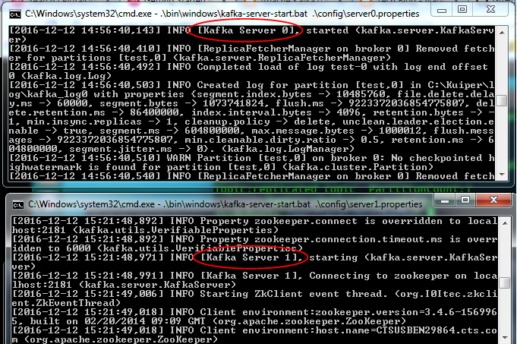
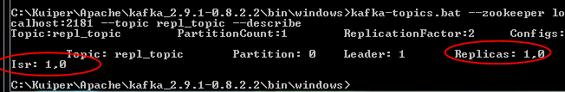
Kafka configuration

Slide 8
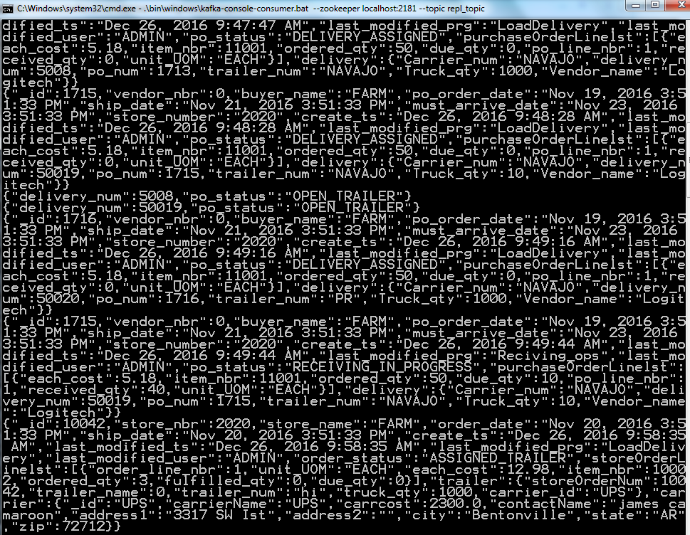
Kafka Consumer’s Kuiper will publish real-time messages to its subsystem, where any sub-system can subscribe for real-time updates from Kuiper.

Slide 9
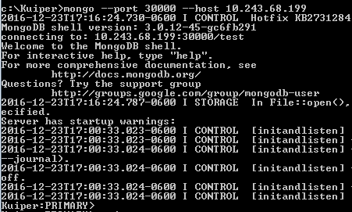
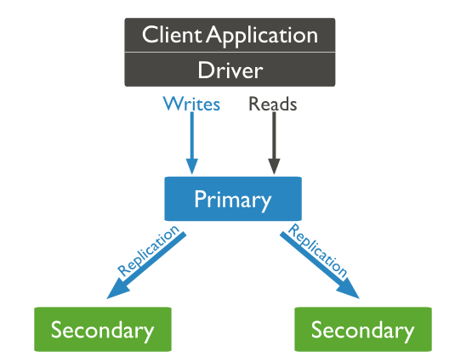
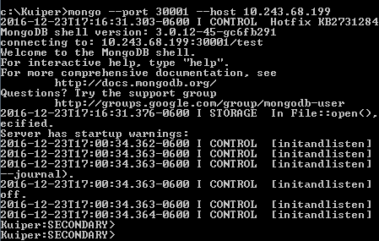
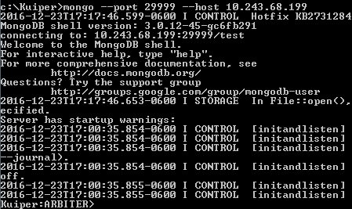
Mongo DB configuration

Slide 10
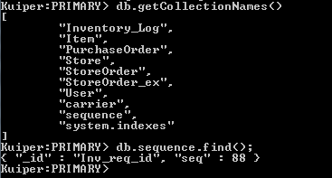
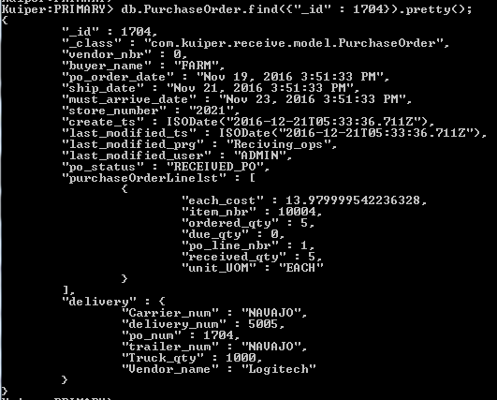
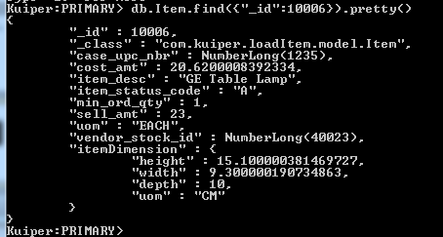
DB MODEL

Slide 11
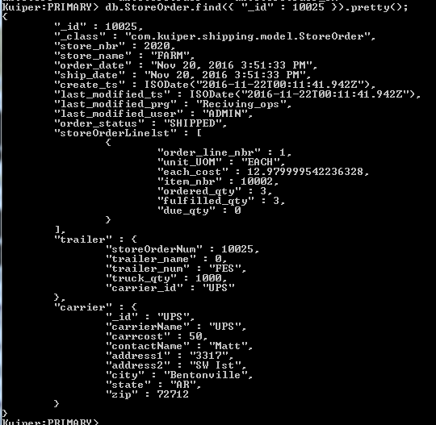
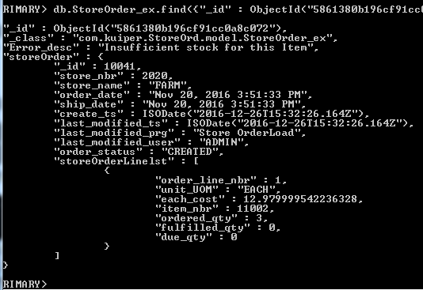
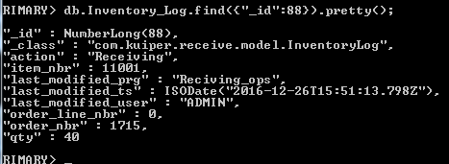
DB MODEL

Slide 12
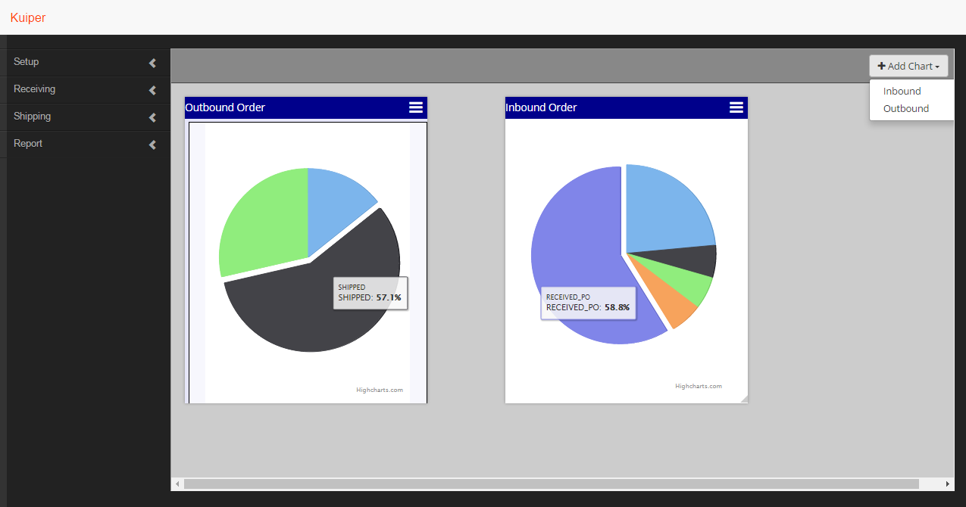
Snap Shot of Kuiper – Dash Board Dashboard with customizable chart widgets

Slide 13
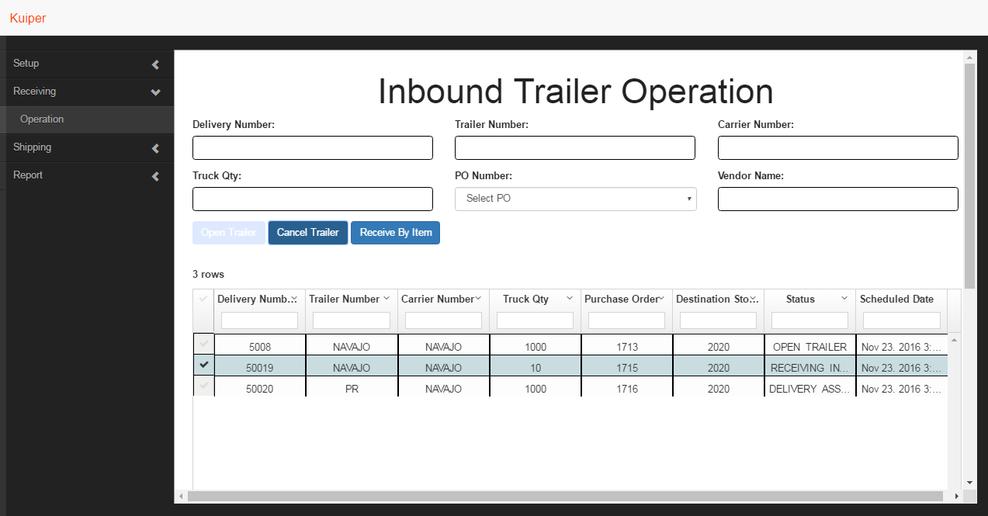
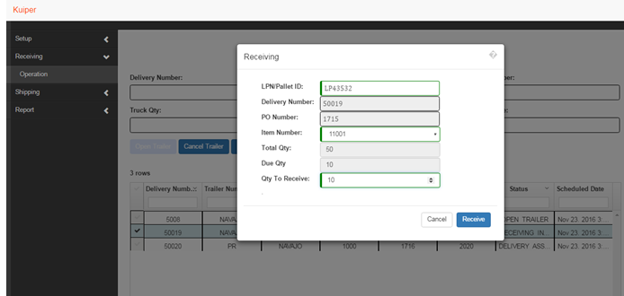
Snap Shot of Kuiper – Inbound process
inbound operation with following feature
assign delivery to a purchase Order
open trailer
cancel trailer
receive purchase Order by item

Slide 14
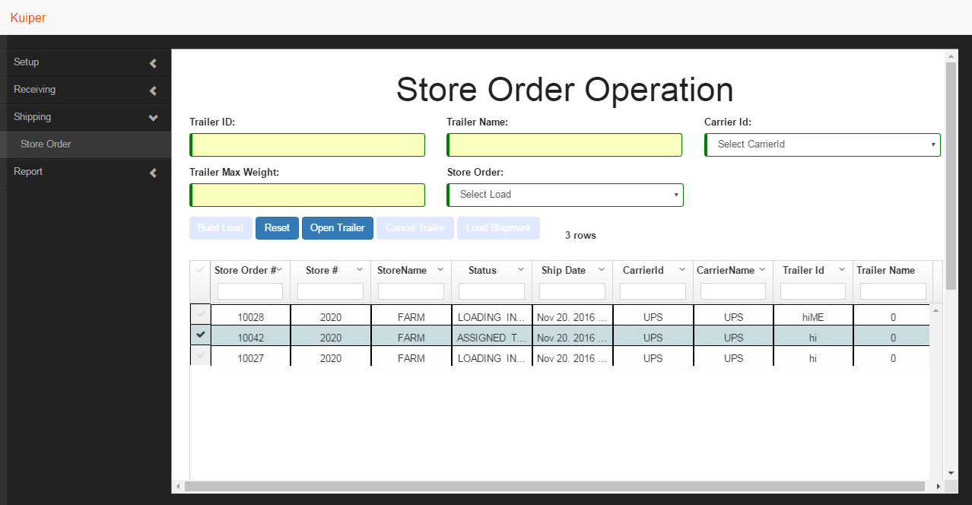
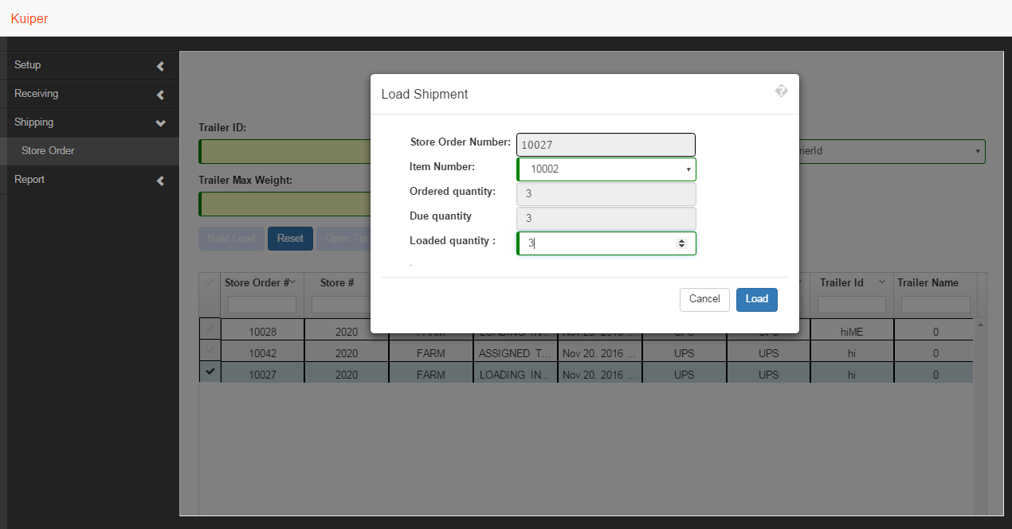
Snap Shot of Kuiper – Outbound process
Outbound operation with following feature
Assign Carrier to a Load
Open Trailer
Cancel Trailer
Load Shipment

Slide 15
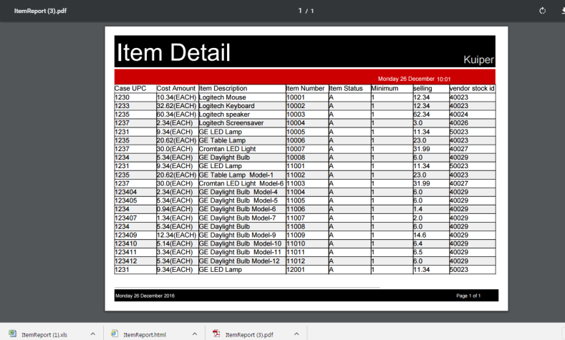
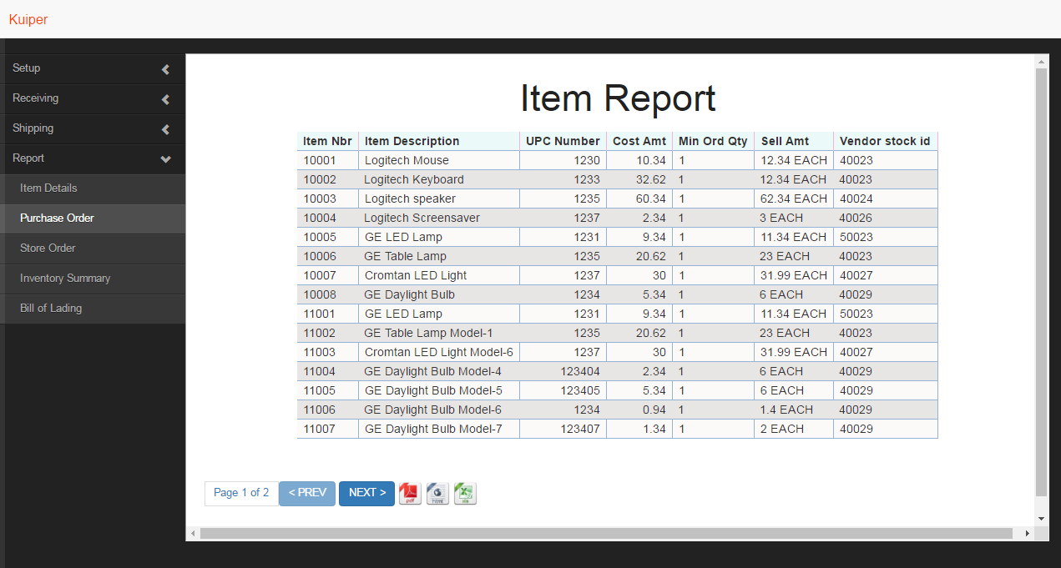
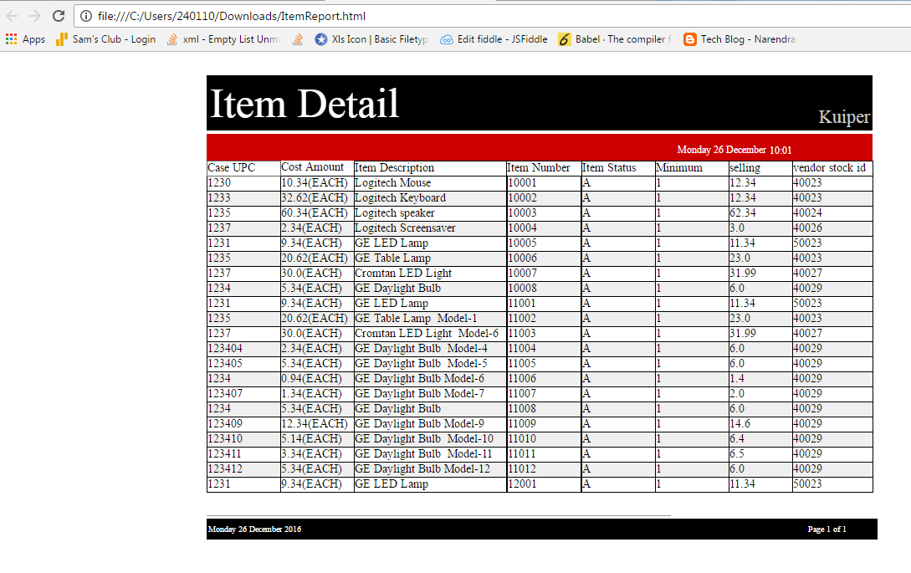
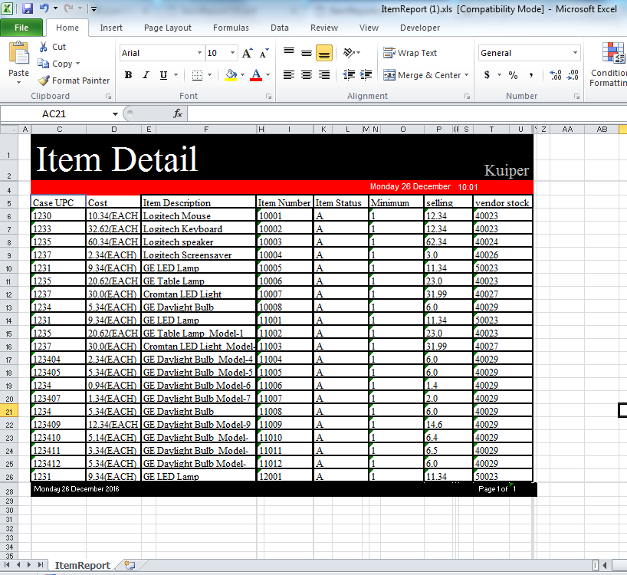
Snap Shot of Kuiper – Report Reports that supports pdf,html & xls format

Slide 16
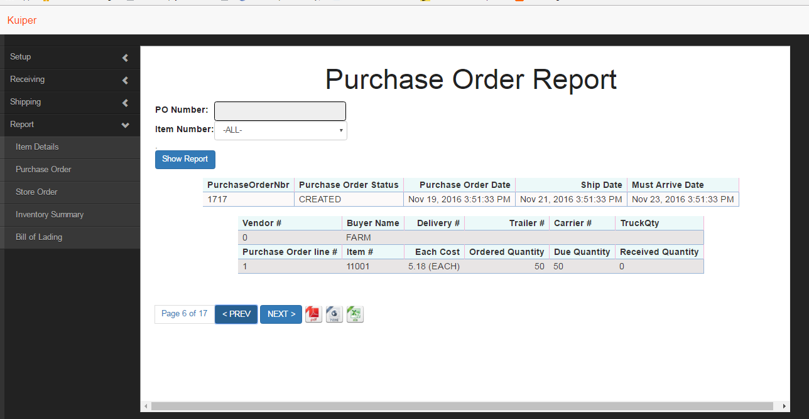
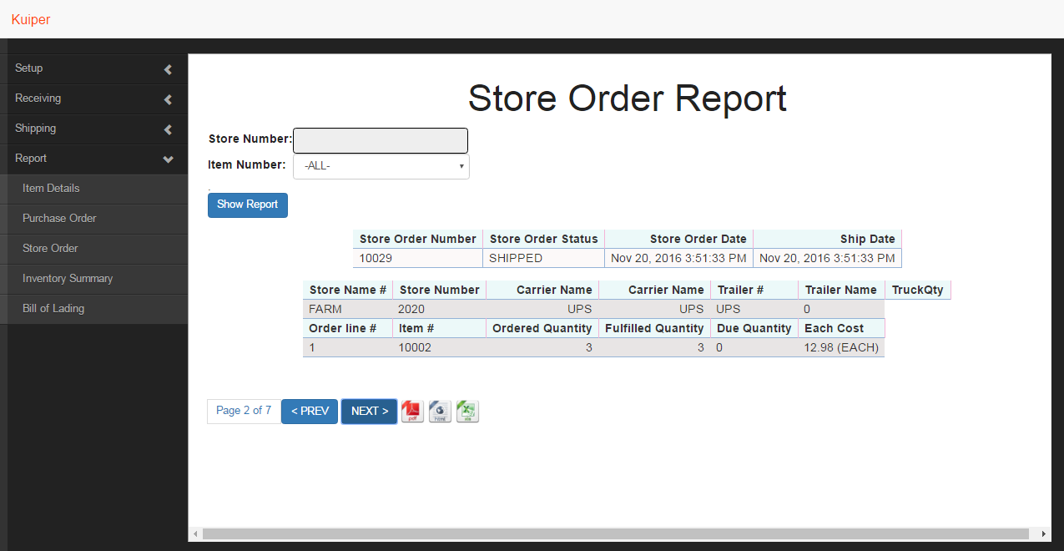
Snap Shot of Kuiper – Reports

Slide 17


Slide 18


